Slide 1
Chapter 14

Slide 2
Objectives

Slide 3
Objectives (cont.)

Slide 4
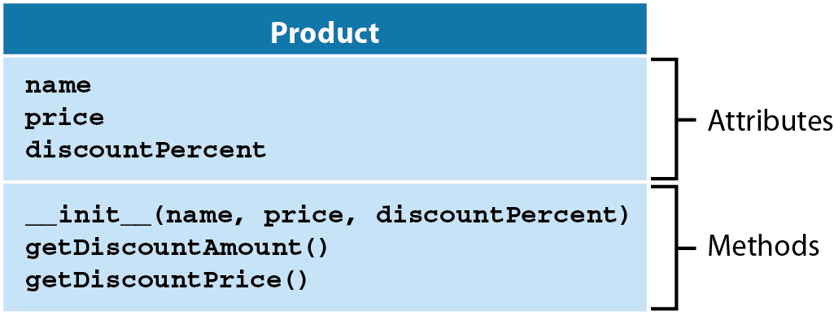
A diagram of the Product class

Slide 5
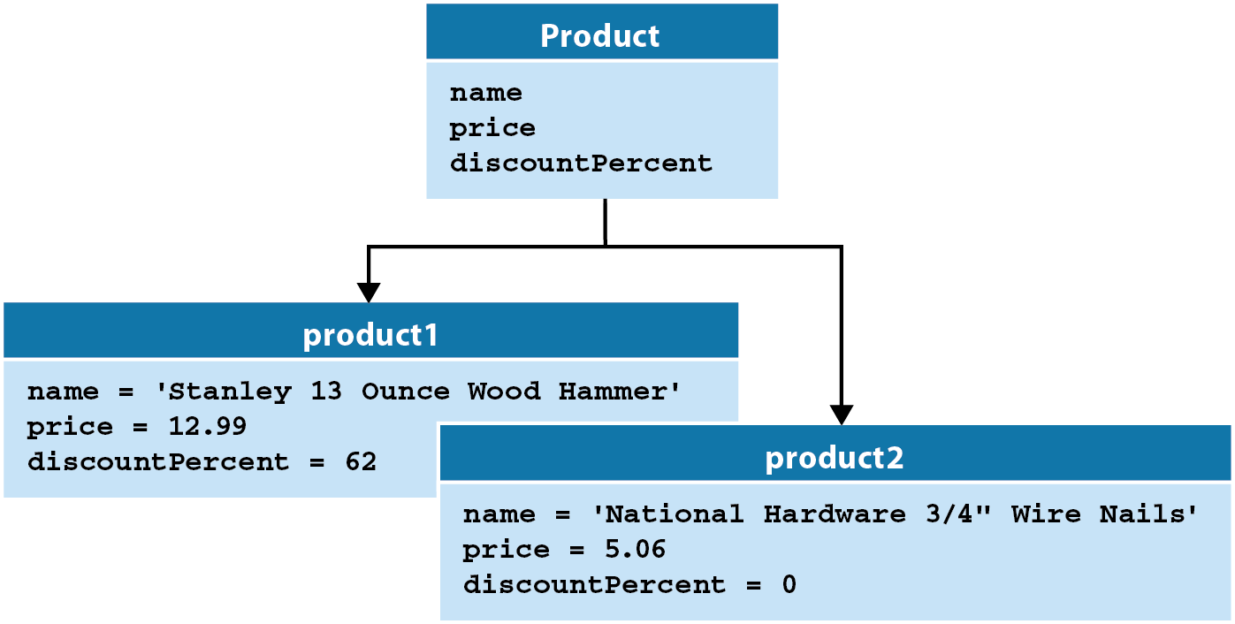
The relationship between a class and its objects

Slide 6
UML diagramming notes

Slide 7
The Product class in the module named objects

Slide 8
A script that creates and uses a Product object

Slide 9
How to import a class

Slide 10
How to create an object

Slide 11
How to access the attributes of an object

Slide 12
How to call the methods of an object

Slide 13
The syntax for coding a constructor

Slide 14
A constructor with no parameters

Slide 15
A constructor with three parameters

Slide 16
A constructor with default values for parameters

Slide 17
The syntax for coding a method

Slide 18
A method that calls another method of the class

Slide 19
A method of the Product class that accepts a parameter

Slide 20
The error that’s displayed if you forget to code the self parameter

Slide 21
The console for the Product Viewer

Slide 22
The objects module

Slide 23
The product_viewer module

Slide 24
The product_viewer module (cont.)

Slide 25
The product_viewer module (cont.)

Slide 26
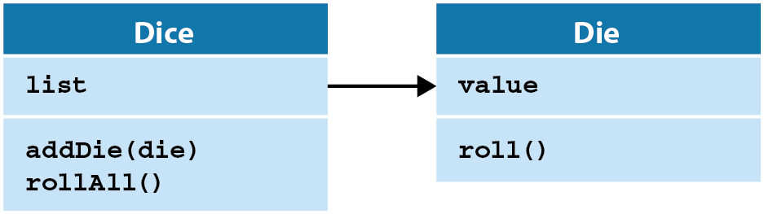
A UML diagram for two classes that use composition

Slide 27
The dice module

Slide 28
The console for the Dice Roller

Slide 29
The dice_roller module

Slide 30
The dice_roller module (cont.)

Slide 31
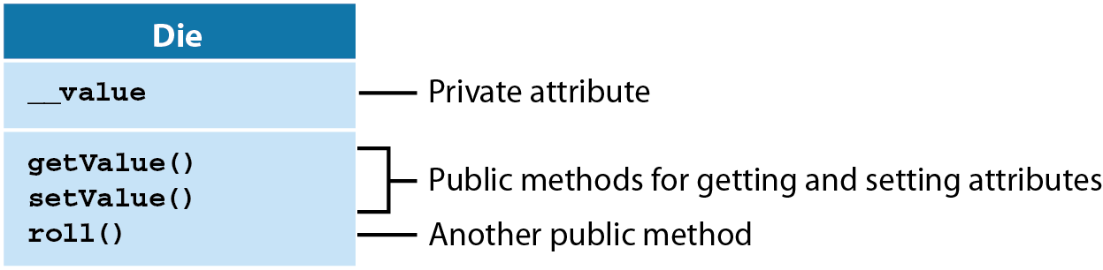
A Die class that uses methods to provide encapsulation

Slide 32
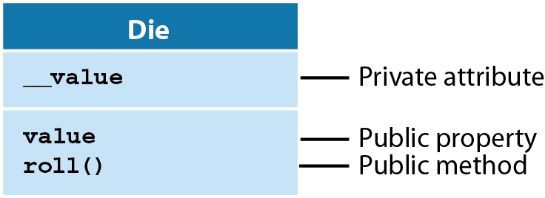
A Die class that uses properties to provide encapsulation

Slide 33
The Die class with a public attribute named value

Slide 34
The Die class with a private attribute named __value

Slide 35
The Die class with methods that access a private attribute

Slide 36
Code that uses the getter and setter methods

Slide 37
Code that attempts to use the setValue() method to set invalid data

Slide 38
Two annotations for getting and setting properties

Slide 39
A Die class that uses a property to access a private attribute

Slide 40
Code that uses the value property to get and set data

Slide 41
Code that attempts to use the value property to set invalid data

Slide 42
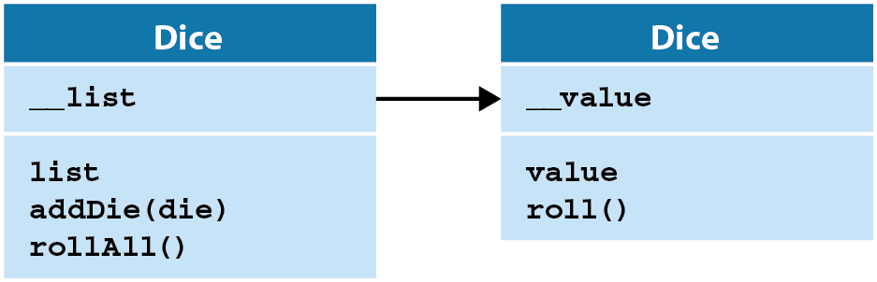
A UML diagram for two classes that use encapsulation

Slide 43
The dice module

Slide 44
The dice module (cont.)

Slide 45
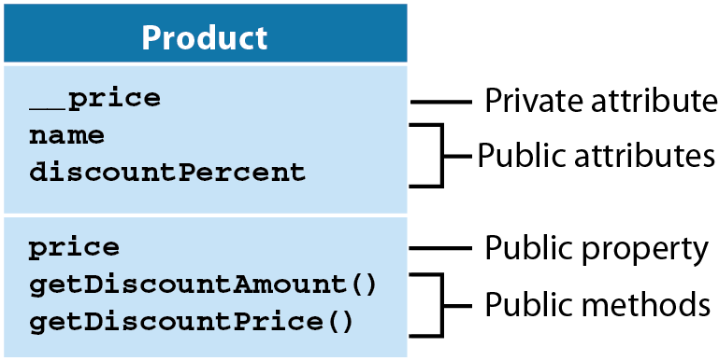
A UML diagram for a Product class that uses some encapsulation

Slide 46
The code for the Product class

Slide 47
The code for the Product class (cont.)

Slide 48
Code that attempts to use the price property to set invalid data

Slide 49
The console for the Pig Dice game

Slide 50
The game module

Slide 51
The pig_dice module (continued)

Slide 52
The pig_dice module (continued)

Slide 53
The pig_dice module (continued)

